Slide 1
Pico-Projectors
LICN Lecture
September 5, 2012
Dmitriy Yavid, Broad Shoulder Consulting LLC

Slide 2
Introduction
Pico-Projectors are sharing many mature technologies with their “big brothers”
Yet miniaturization imposes unique requirements, shift priorities and calls for innovative solutions
The market is small so far, but the prize might be huge: cell phones
Surprisingly wide array of technological opportunities
No dominating market player yet emerged

Slide 3
Summary
This is a technical presentation: any market analysis is purposefully avoided, except where it has direct bearing on technology
An overview of general projection technologies is given
Factors which makes pico-projectors different from desktop ones are explained
Most attention is paid to fundamental physical limitations
Optical, mechanical and electronic aspects are covered, as they all are tightly intertwined in pico-projectors.

Slide 4
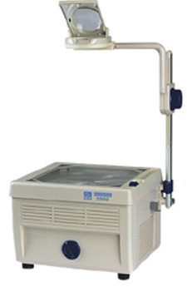
History
Various film projectors are more than 100 year old
There was always a need to project “dynamic” content
Older generation still remembers overhead transparency projectors
Half-page sized, translucent LCD screens placed on overhead projectors – became the first dynamic projectors ~25 years ago
In the 90’th the 3-LCD desktop projectors are introduced
Mid-90’th: TI’s DLP technology takes over. Desktop projectors become ubiquitous

Slide 5
What makes a good projector?
Brightness
  Projectors can’t project black, they have to compete with ambient light to make it look black in comparison with projected white
Resolution
  Has to match other common displays
Color gamut
  For various reasons, its more difficult to achieve good color representation in a projector

Slide 6
Brightness
Broadly, depends on the light source used
A typical well-lit room is 300 lm/m²
To have meaningful contrast, projector needs at least 1000 lm/m² or more for comfortable viewing
Typically, either light is dimmed or projection area reduced
When people are screaming for brightness, they usually mean contrast
Hard to compete with flat panels, where black is really black

Slide 7
Resolution
The number of pixels in the imaging element
For non-imaging projectors, the definition is not so simple, but broadly equivalent: a number of optically-resolvable spots
  Depends on optical aperture
Tries to keep pace with other available screens, but usually a step or two behind
Pixels are not born equal: optical resolution might be a factor
Usually, not an issue for desktop projectors
  Important for pico-projectors

Slide 8
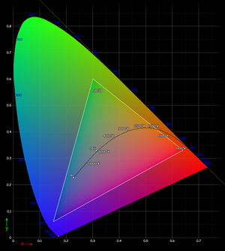
Color Gamut
The ability to accurately reproduce colors
Critical for any display, but particularly hard to achieve in projectors relying of filters
To begin with, the light source must contain all the colors needed
Broadly speaking: two approaches:
  Single white source, broken up into 3 primary colors
  Three separate sources

Slide 9
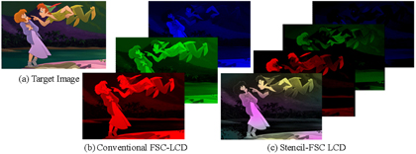
Refresh rate and color break-up
Some projectors rely on projecting 3 color sub-frames sequentially
Doing it at the conventional refresh rate of 60 Hz is not sufficient, because of “color break-up” in fast-moving scenes.
A particular problem for LCDs – they are typically not fast enough

Slide 10
Optical modulation methods
How to direct light where we need it?
Broadly, two methods:
Spatial modulation: the entire image is formed at once, light directed where needed and blocked where not needed
  In theory, the light doesn’t have to be blocked, it may be re-directed: holographic projection
Time-domain modulation: image is painted pixel-by-pixel

Slide 11
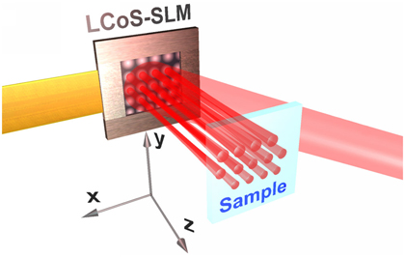
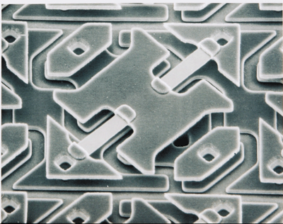
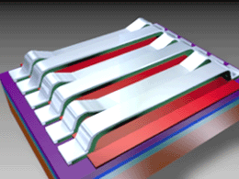
Spatial Light Modulators
LCD: pixels turned on or off by changing the polarization of a liquid chrystal
  Only woks with polarized light
  Could be transmissive or reflective
DLP: tiny mirrors turned mechanically, to direct light either in or out of optical system
GLV: mirrors move up and down to create either positive or negative interference pattern
  Analog–modulatable
In principle, and array of tiny LEDs would be a perfect imaging projection element – not practical at this time

Slide 12
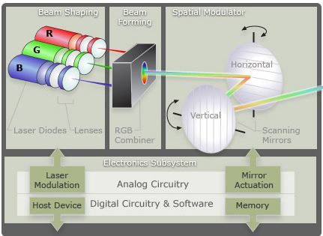
Time domain modulation
Classic example: CRT display
  Electron beam scanning an array of phosphorescent pixels
  There have been CRT projectors in fact!
Modern version: laser scanner
  3 laser beams scanning the target and switched on/off to paint an image
  Scanning in provided by mechanical mirrors
  Alternative methods exist, but presently not practical (Acousto-Optics and Electro-Optics)

Slide 13
Hybrids
Image is painted one line at a time
A line image is created by a 1D imaging source
  Has to be fast – 10’s of kHz
  GLV qualifies
  A linear array of lasers – would be good, but not available yet
Lines are projected through a slow scanning mirror to form the image
  That’s the easy part

Slide 14
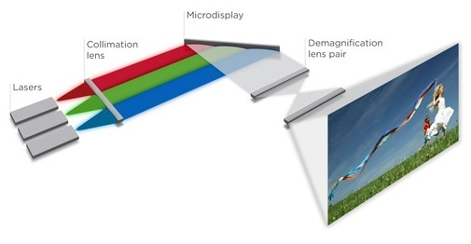
Holographic projectors
A name is a bit of a misnomer: no 3D hologram is involved
However, the principle is the same: not the amplitude, but the phase of the light wave is modulated
  Turns out “conventional” LCD can do that
The interference pattern is formed, where no light is wasted, it is just directed where it is needed
  Complex optics and enormously complex electronics

Slide 15
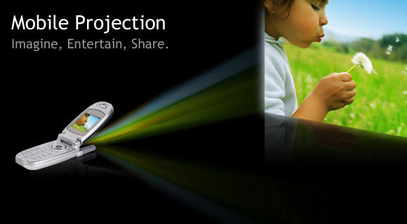
Pico-Projector: what’s that?
No universally acceptable definition
Generally, a projector which is:
  Hand-held
  Battery-powered
A pie in the sky: a projector in a cell-phone

Slide 16
Scaling projectors down
Obviously, the physical size has to go down
Power consumption has to go down
  Desktop projectors typically not concerned with power efficiency
Depth of focus:
  It’s totally ok to re-adjust the focus of a desktop projector when setting it up
  Not acceptable for hand-held
Last but not least: has to be cheap
  The costliest cell-phone component is $25

Slide 17
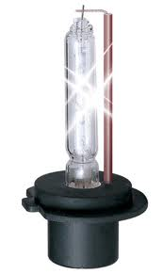
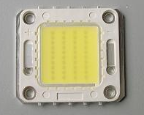
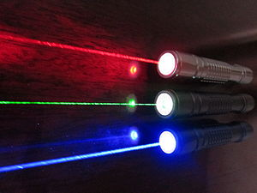
Light source
Most desktop projectors are lit-up by xenon lamps
  Good source, but they are not scalable
LEDs:
  Enormous progress over last decade
  Driven by other huge markets: flat panel, automotive, general lighting
Lasers:
  Inherently better (with reservations)
  Red: readily available
  Blue: available and improving, BlueRay is a big boost
  Green: just coming out

Slide 18
White LED vs. color LEDs
White LEDs are, in fact, blue LEDs with added yellow phosphor
The most efficient ones
  Subsequent filtering eats up all the savings
  Also, the spectrum is not continuous
By far, the simplest and most compact optical design
  A single LED
  No color combining
Three-LEDs sources have better gamut

Slide 19
Power efficiency
A variety of loss mechanisms leaks light out
  The light source itself has limited efficiency: not every electron is converted to photon
  Spectral losses: some colors are harder to come by that others
  Color wheel loss: any filter discards anything which is not passing through
  Polarization loss (LCD-specific)
  Imager loss: pixel fill factor and reflectivity/transmissivity of open pixels
  Optical loss: not all light is directed to the target
  Electric loss: power supplies, fans, data processing – takes away power
Overall efficiency of desktop projectors: a few %
  Pico-projectors must do better

Slide 20
Luminous efficiency
The ability to convert current into light
  Projector lamps: ~30%
  Commercial white LEDs: ~10%
  Cutting edge white LEDs: >50%
  Cutting edge green LEDs: ~ 10%
  Red and blue lasers: ~20%
  Green lasers: ~5% (improving fast)
A problem with LEDs: efficiency suffers at high-current density
  Either bright or efficient, but not both together
For lasers, it’s the opposite: brightness and efficiency goes together

Slide 21
Modulation
Imaging projectors typically discard the light which would go to dark pixels
The backlight has to stay on even if only one pixel is lit up
The average light content in a color photo or movie scene is ~25%
  White text on black background: ~5%
Scanning projectors DO NOT waste this light: the lasers are turned off
  Very important advantage!

Slide 22
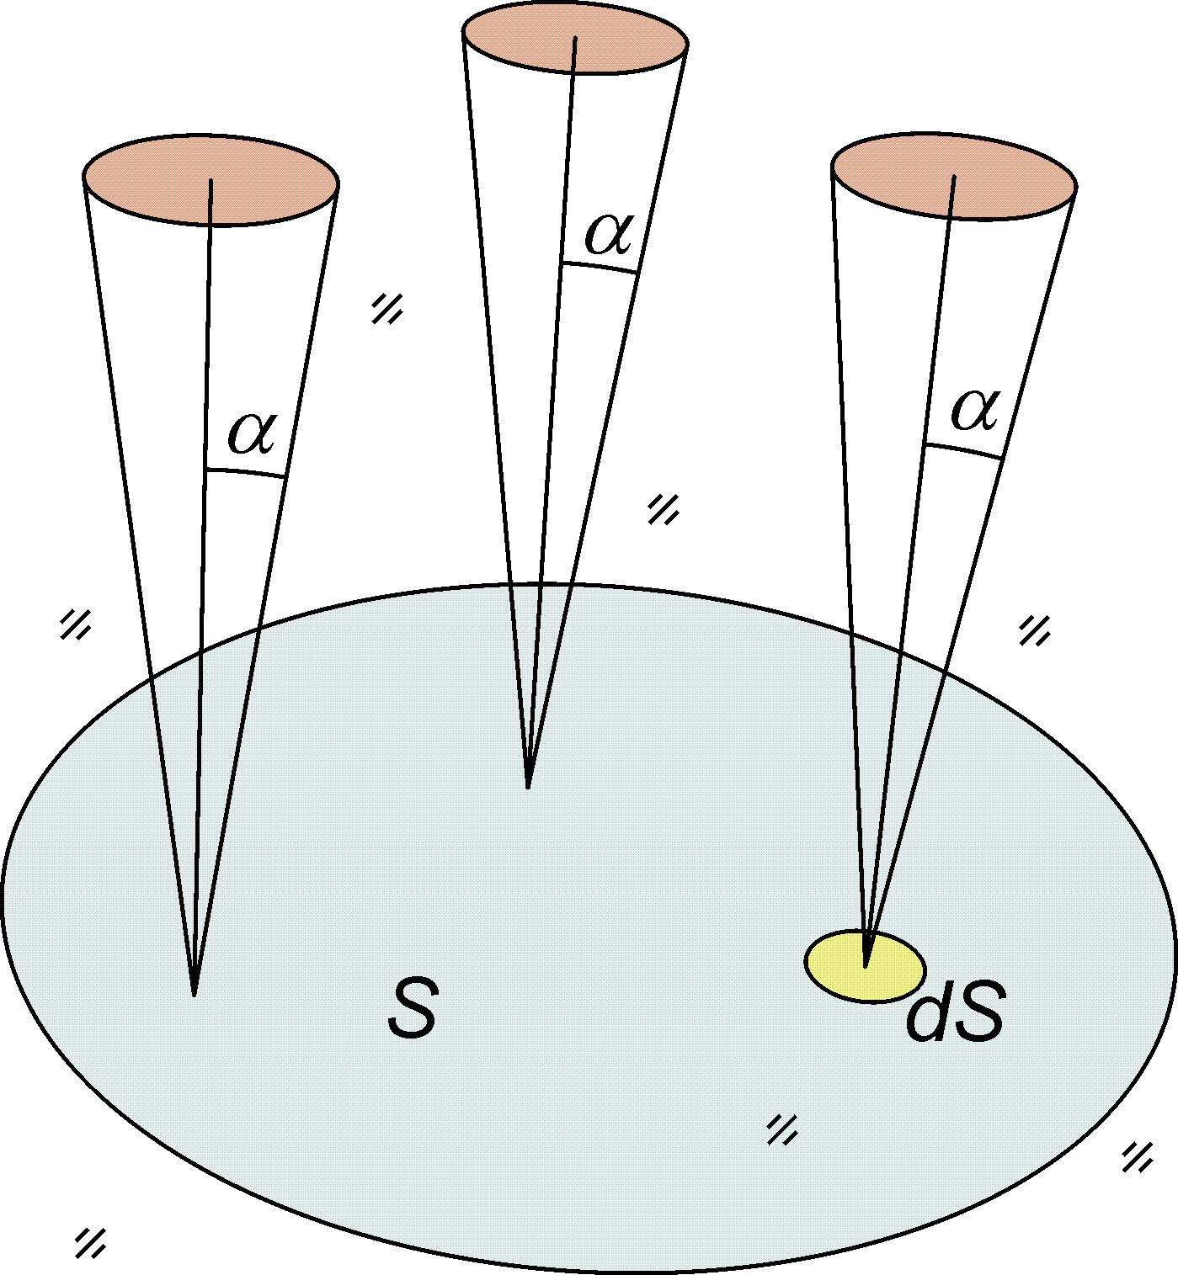
Etendue
Product of source’s emission area and emission angle
Effectively, the ability of the source to project light into a sharp point
Cannot be reduced optically
Very small for lasers
Large for LEDs

Slide 23
Light collection
The challenge is to collect as much light as possible from a large, wide-angle LED, direct it on a SLM and then direct into the projection lens
  Losses are unavoidable
  The smaller size, the greater losses
Contrary, lasers sources do not have this problem, because their etendue is much smaller

Slide 24
Polarization losses
LCD are polarization-sensitive: only one polarization is used, the other is discarded
LEDs are NOT polarized
  Lasers are
The light of “other” polarization, can in principle be collected, turned by 90 degrees and re-used.
  Optical design is complicated
Research underway into forcing a preferential polarization on LEDs – not practical so far

Slide 25
Optical aperture
Just like in photography:
  Larger aperture allows more light, reduces the depth of focus
Laser beam is small, laser projectors do not suffer from this trade-off (almost)
For imaging pico-projectors, a combination of large source etendue, and small optical aperture creates an inexorable trade-off between DOF and efficiency
  Unless lasers are used as light source

Slide 26
Speckle noise
Lasers are coherent light sources
  All the light is in the same phase
Reflected from rough surface, creates interference pattern, which looks like tiny bright and dark “speckles” on the image
Human eye is involved, hence sensitivity of different people is vastly different
  Still, a major drawback of laser light sources

Slide 27
Speckle noise mitigation
Time-averaging: If speckle noise pattern is shifted with the frequency higher then projector refresh rate, it becomes less visible or not visible at all
  Relatively easy in imaging projectors: moving diffusers
  Tough, but possible in hybrids: need to move very fast
  Impossible in scanners
Optical broadening: laser may, in principle, emit relatively broad spectrum
  Not available commercially, but promising work is underway

Slide 28
LCoS vs. DLP
DLP losses are lower
  unless the “other” polarization recovered or lasers are used
DLP is faster
  No color break-up in sequential field
DLP pixels are larger, making the whole chip larger at the same resolution
  11 um available
  7 um underway
  Still, XGA chip would be >0.5” diagonal
5um LCoS chips are available
  Further reduction well possible
Size = Cost. DLP is more expensive and probably will stay that way

Slide 29
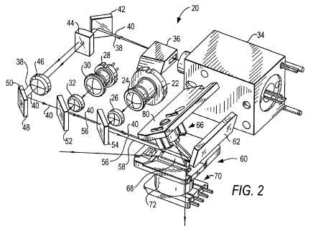
Scan engine
Complex, opto-electro-mechanical system
  Fast mirror
  Slow mirror
  Laser modulation synchronized with mirror’s motion
  Unconventional electronics to account for changing scan speed and scan direction
  Excruciating mechanical tolerances
On a plus side:
  Relatively simple
  optics
  No fundamental
  limitations of size –
  can be very small!

Slide 30
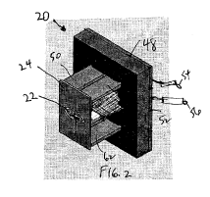
Fast mirror
Must be very fast indeed
  60 frames/second x 768 lines = ~46 kHz
  2 lines per cycle – that’s 23 kHz mechanical frequency
  Practically, needs to be even higher: ~30 kHz
  Higher resolutions requires even higher frequencies
  To put things in perspective: an edge of 1.5 mm mirror flies at ~125 ft/sec!
Silicon MEMS – very high Q-factor
Piezo-electric drive – very efficient

Slide 31
Fast mirror as an optical aperture
Plays the same role as the imaging lens
  Defines optical resolution
  Defines depth of focus
To increase the resolution of a scanning projector, the mirror has to become both bigger and faster – very contradictory requirements!
But it also have to become thicker
  Otherwise, starts to “flap” under enormous acceleration
The physical limit is not reached yet, but must be near.
  Still, full HD is probably possible and this will be sufficient for pico-projectors for many years

Slide 32
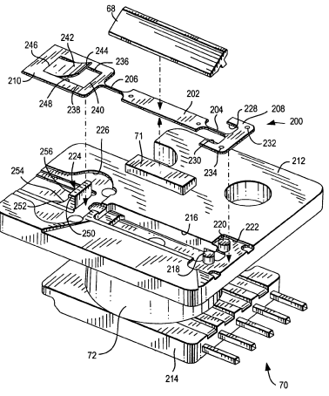
Slow mirror
Must move at constant speed to preserve line spacing
  NOT what a scanning mirror likes to do
  On the other hand, needed
  power is microscopic, drive
  doesn’t have to be highly
  efficient
A variety of designs exist:
  MEMS and non-MEMS
  Magnetically-driven
  Electro-statically driven

Slide 33
Electronics
Data clocking must be synchronized with mirrors
Scan lines change directions
The speed of the beam is non-uniform: at the end of the line, it just stops
Lines must be projected at the frequency of the fast mirror (which is unique for the mirror and may drift with temperature)
  Needs data buffering
Laser modulation needs to be fast and efficient
  Otherwise, power advantage over imagers go away

Slide 34
Cost
Ultimately, the cost of a pico-projector is defined by the light source
Presently, a lumen of light from LED is an order of magnitude cheaper than from lasers
  This is due to market volumes, NOT fundamental limitations
Cost of electronics defined by wafer area
Lasers have much higher power density, but wafer utilization in lower and processing is more complex
Jury is still out on ultimate limit, healthy competition ahead

Slide 35
Who’s the winner?
Clearly, laser scanners have no place in desktop projectors
However, they ARE NOT subject to the fundamental size/efficiency trade-off AND they have a fundamental modulation efficiency advantage over imagers
Presently, market advantages of imagers are masking their fundamental problems
As pico-projectors continue to shrink into embedded ones, laser scanners will probably come on top
Speckle noise remains laser’s most intractable problem

Slide 36
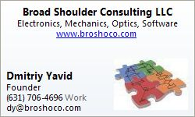
Thank you for attention!
Questions? Don’t hesitate to contact me.

